Slide 1




Thinkuknow parents and carers presentation
(primary)
Protect your children from sexual abuse online
www.thinkuknow.co.uk/parents
Notes:
Note to presenter: Please read through the presentation thoroughly before delivery and familiarise yourself with the Thinkuknow websites (www.thinkuknow.co.uk) and NCA-CEOP Safety Centre (www.ceop.police.uk) if needed. There are delivery notes and instructions in italics on some slides to aid your delivery.
Introduce yourself and your role to your audience.
This presentation has been developed by the CEOP Education Team at the National Crime Agency (NCA). Thinkuknow is the national education programme from NCA-CEOP, dedicated to keeping children safe from sexual abuse and exploitation both online and offline.
NCA-CEOP is a multi-disciplinary child protection centre, staffed by law enforcement officers, social workers, education officers, intelligence officers, child psychologists and many more.
Parents should visit www.thinkuknow.co.uk/parents (on screen) for further information and advice on supporting their child to be safe online. Please encourage your audience to look at the website after this session as it has lots more information on how they can protect their child online.

Slide 2



This presentation will cover:
Children online
Live streaming and gaming
What can you do?
Thinkuknow resources for primary
Thinkuknow resources for parents and carers
Reporting to NCA-CEOP
Notes:
This presentation will cover:
Children online – The impact of growing up online
Live streaming and gaming – Two of the current most popular online activities for children
What can you do? Advice for parents and carers
Thinkuknow resources for primary aged children
Thinkuknow resources for parents and carers
Reporting to NCA-CEOP – Children and young people, as well as their parents and carers, can report directly to CEOP if they are concerned about CSAE

Slide 3

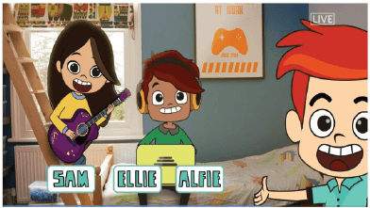
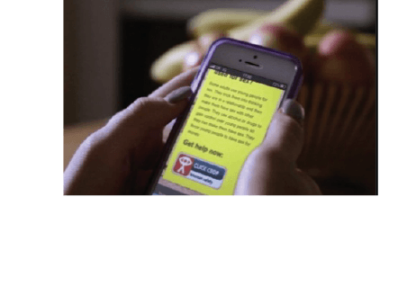
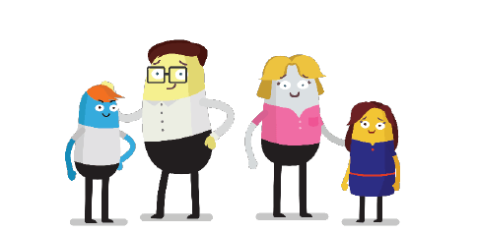
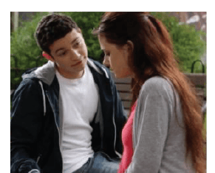
What is Thinkuknow?
Thinkuknow is the education programme provided by CEOP.
Thinkuknow offers resources for different audiences:
4-7
8-10
11-13
14+
Parents and Carers
Resources for those with special educational needs and disabilities (SEND)
Visit www.thinkuknow.co.uk for information and advice
Notes:
What is Thinkuknow?
Thinkuknow is the national education programme from NCA-CEOP. It provides professionals with resources to teach children and young people about sexual abuse online and covers the following age ranges: 4-7, 8-10, 11-13, 14+ and also children with special educational needs and disabilities. Thinkuknow includes films, animations, websites, presentations and lesson plans to enable professionals to explore difficult and sensitive issues safely with children and young people.
In addition to providing professionals with resources to tackle CSAE and information for children and young people, Thinkuknow creates information and advice for parents and carers to help build their confidence and knowledge in protecting their children online. Thinkuknow also offers expert advice to parents and carers supporting children who are victims of sexual abuse and exploitation. This presentation is part of the Thinkuknow package for parents and carers.
Parents should visit www.thinkuknow.co.uk for further information and advice.

Slide 4




Talk to your child
Find a good time and place
Think about how you are going to introduce the subject
Explain any worries you may have
Where do they go online?
What do they like?
What don’t they like?
Make sure they know they can come to you
Listen. Don’t judge. Learn…
Notes:
Talk to your child
The best way you can protect your child is to establish a positive relationship with them around their life online. Talk to them – not just once, but have ongoing conversations as part of your family life.
Find a good time and place. Pick an opportunity when you know you’re not going to be interrupted and you are both going to feel comfortable and have enough time – without turning it into one of those ‘special talks’ moments.
Think about how you are going to introduce the subject. You could mention a recent story that they might have heard about or just explain why you would like to talk to them about something.
Explain to them any worries you have. Your child might think that you are getting worried for no good reason, but if you explain why something is troubling you they will understand why you want to talk to them. Tell them if it is something you have read about or seen their friends doing.
Listen. Don’t judge. Learn. Find out more about what they encounter online; what they are doing, where they go, what they like and don’t like. Parental engagement in the positive aspect of being online and not just the risky things will help your child to talk more openly about their internet use, including anything that worries them.
The most difficult conversations can be made easier if your child understands that you care about them and whatever the outcome you will love them just as much. One of the biggest barriers to young people seeking help if something goes wrong online is the fear of being blamed, getting into trouble, and suffering repercussions (such as tech being taken away). Make sure your child knows that they can come to you for help if they are ever worried and that they won’t get into trouble. Young people who are banned from going online, or who feel that what they are doing is wrong, are less likely to ask for help and that makes them less safe.
This is not on the slide but an important point to raise. Parental controls - Controls are an important first step to helping to protect your child online, but they are not a single solution to staying safe; talking to your children and encouraging responsible behaviour is critical. For detailed guidance on all the different types of control, you can use this online tool from Internet Matters. This gives you the chance to set up a personalised list of the controls used in your home on all your different devices. There is also advice on how to use all the various controls, with videos and step-by-step instructions.

Slide 5

The World Changes. Children Don’t.
Notes:
Insert video file to slide - ‘The World Changes. Children Don’t’
‘The World Changes. Children Don’t’ is a video made by NCA-CEOP for parents and carers. It shows what Shakespeare's story of Romeo and Juliet would look today with the influence of technology in relationships.
The point of the video is to demonstrate that children and young people haven’t changed, they are still doing all of the same things adults did when they were young, but in new ways. Although the story shows a ‘romantic relationship’ the point applies to online friendships too. Social media has changed the way young people communicate but their curiosity about friendships and relationships remains the same. Having a supportive parent or carer can make all the difference in helping children explore these themes as safely as possible.
Talking about relationships and the internet with young people can feel daunting, and Thinkuknow has a lots of advice and resources to help parents and carers have these conversations. Please visit the website for further information and advice.

Slide 6




Understanding apps and games
Sharing
Chatting
Viewing
Friending
Notes:
Parents and carers have told NCA-CEOP that they can feel overwhelmed by the internet. The emergence of new apps and games every day can make the internet feel vast and ever-changing, but the reality is that there are actually only a limited number of functions that apps and games can have.
NCA-CEOP recommend using a simple technique of breaking down an app into its key functions of ‘Viewing, Sharing, Chatting, Friending’, and asking some simple questions in order to gain a better understanding of how the app works.
Viewing - What content can they see? Is it age appropriate? What filtering/privacy settings can be utilised? Unfortunately it can be easy for children to come across inappropriate, sexual or violent content online. Most apps and games (but not all) include privacy and security settings that allow you to control what content can be seen and shared. In addition, tools such as parental controls and filters can help to manage a child’s online activities and what they are exposed to, however these are never totally fail-safe. What is vital is open and ongoing conversations with young people about what they see online, and making sure they are that they can talk to an adult if they see anything online that upsets them.
Sharing – What are they sharing and who are they sharing it with? A key part of our education with children is talking to them about what they share online. It’s easy to share things online that we wouldn’t face-to-face and it’s important to talk to children about safe sharing. Children of primary school age are always encouraged to seek permission whenever they share something online, especially if they are sharing a photo with other children in it. We also want to encourage children to look out for others by not sharing inappropriate content.
Chatting and Friending – Who are they friends with and what are they sharing? Chatting and meeting new people on the internet can be fun and appealing for children. There are lots of online apps and communities that can be educational and supportive for them, however this opens up the opportunities for adults to contact children online. No matter how young your child is, if they are using a device that has the internet- it is important to talk to them about people who contact them online. Some people online genuinely just want to chat or be friends, but others may put pressure on children or manipulate them.
Resources to support you to have these conversations with your child will be covered at the end of this presentation.
Which apps should I be concerned about? There are no apps/games that are more or less dangerous or risky. People who want to groom children will use any sites or services which children use. Children should know to be wary of people they friend and talk to online, especially if they are asking to talk privately with them, and children should always be advised not share personal information online or any photos or videos that make them feel uncomfortable. Most importantly, it is vital that they know that they can talk to a trusted adult if anything bothers or worries them.
Age restrictions exist to make viewers aware of the type of content in a game or app, and it is important that parents and carers are educated on age restrictions. Games and apps enable children to share an incredible amount of information about themselves, have conversations with their friends and also potentially provide contact with people they don’t know. With this in mind, parents and carers should take age restrictions seriously.
Optional activity: Name some popular apps with the group. Ask attendees to tell you which apps/games their children like to use. Do they know how they work? What questions could they ask for more information?

Slide 7
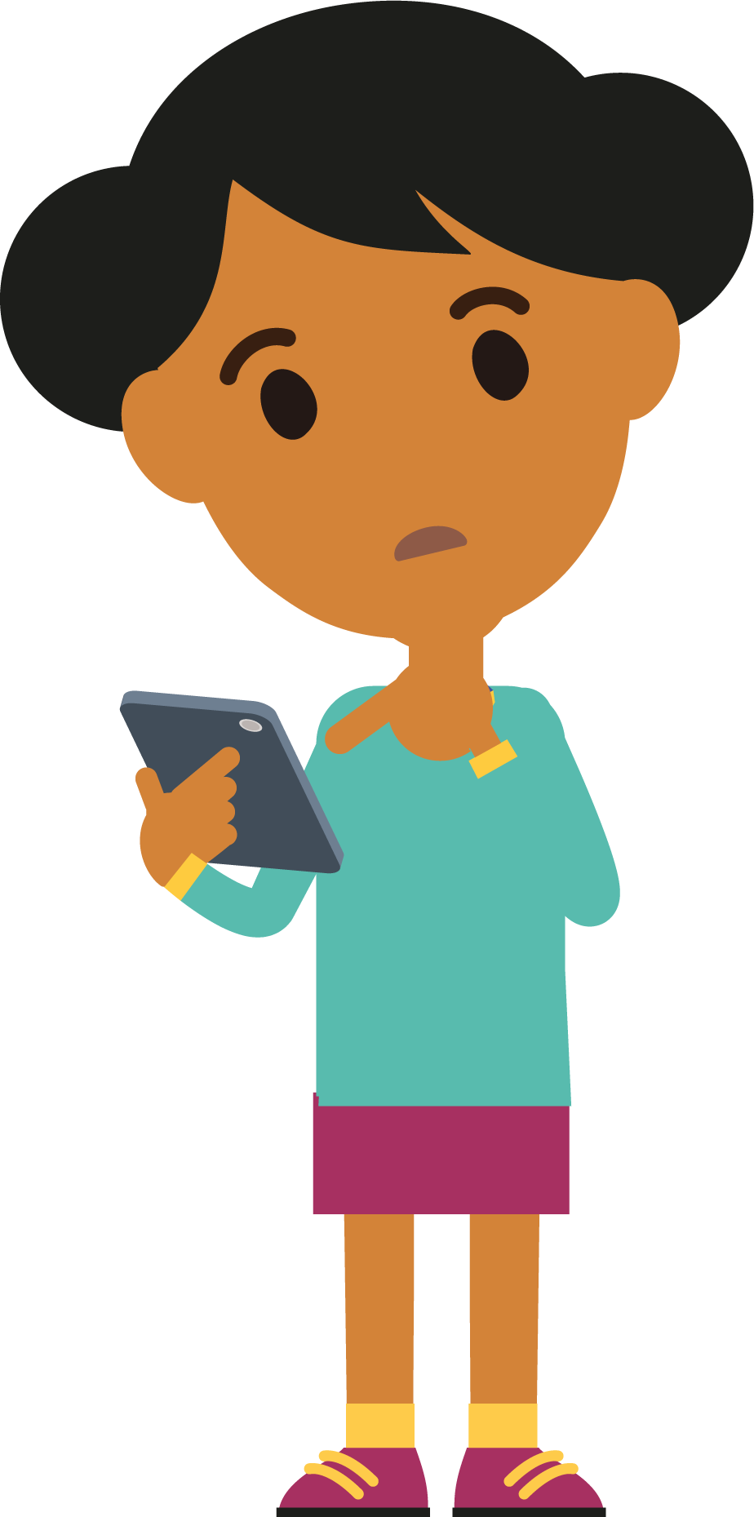

Live streaming
Broadcasting live videos over the internet. Unmoderated & unpredictable
Hugely popular with primary aged children
Potentially huge audiences
The risks
Children may not understand the risks of broadcasting to strangers. Younger children are especially vulnerable to pressure and manipulation.
Offenders can use flattery, threats, dares and tricks, or post multiple comments in order to pressurise a young person to do inappropriate things on camera.
Notes:
What is live streaming? Live streaming is a live visual broadcast over the internet. All that is needed to live stream is an internet enabled device, like a smart phone or tablet, and a platform to broadcast on. Examples are: YouNow, Tik Tok, YouTube Live, Instagram Live, Periscope.
The inspiration to live stream takes its lead from reality/live TV and YouTube where you can broadcast anything you are doing across the world. It is without delay and unedited. Viewers can write real-time comments or send virtual gifts (such as emojis) or prizes such as online currency. Live streaming is highly appealing particularly to primary aged children, as it offers the opportunity for them to be a presenter and to be seen by a potentially huge audience.
The risks – there is only a summary of the risks on the slide
Power of multiple comments – Within live streaming apps there can be multiple viewers watching a single live stream. This can make it easier for people to manipulate a child into doing something by increasing the pressure on them through persuasion and comments from multiple sources.
Developmental stage – Children’s brains are still developing and they need lots of support to keep themselves safe. Many of the reports NCA-CEOP receive involve children using live streaming platforms on their own in bedrooms and bathrooms. Within live streaming platforms there can be multiple offenders engaging with a child at a single time and children do not have the skills to keep themselves safe with this context.
Reduced inhibition online – Online children can feel more confident to engage in behaviour that they would not do in ‘real life’. Children may see live streaming differently to sending photos and videos as it is ‘in the moment’ and often they do not realise it can be recorded.
Affirmation – Lots of positive comments and compliments can make children feel good. Primary aged children tend to want to please others and can be tricked into doing things by the threat of losing their followers (the people watching and commenting on their stream).
Tactics such as dares and tricks – This can be games introduced by an offender that start off ‘innocent’ and then build up to trick children into taking clothes off or performing sexual acts.
Fear – Offenders sometimes use threats when they are online to try and force children to do things that they do not want to do, which can sometimes make them feel like they not have any choice but to do what they are being told.
(Note – a specific Live Streaming presentation for parents/carers can be downloaded from www.thinkuknow.co.uk/professionals/resources/live-streaming)

Slide 8


Online gaming
Multi-player games
Chat functions – instant messenger, voice over
Risk from inappropriate content and contact
Offenders can build relationships over online games
Offenders use gifts in gaming to encourage children to trust them
Moving from gaming to private platforms
Notes:
Online gaming
Gaming is a type of social network. Many games have a chat function enabling users to interact with one another. Often the communication within gaming is to coordinate multi-player game tactics, although it can be just to chat as gamers play. Messages can take the form of instant messenger (similar to texting) or voice over internet protocol (VoIP). VoIP allows gamers to talk to one another, usually through a headset, in a group conversation during the game. Some game consoles also allow young people to leave voice messages for other users and to chat even when a game is not in play.
Risk factors
Building relationships over gaming. As with other social networks, the communication within gaming can present a risk to children and young people as gaming platforms can be used by offenders seeking to harm young people. Playing games can be exciting and consuming for children and sometimes this can mean that they can become a little less guarded when considering who they talk to and what they share. It may also be seen as ‘normal’ to talk to adults in a game – especially if children can learn from them – than it would be to talk to an adult on another social media platform. Some offenders seek to exploit this and ‘help’ children to develop in a game with the aim of a building a relationship with them.
Offenders may also offer gifts, cheats, tips within gaming to try to encourage children to trust them.
Offenders may also try to encourage a child to move from a game to a private messenger platform to have one-to-one conversations with them. These platforms help offenders to build a relationship with a young person quickly, and are often harder to moderate than group chat within games.
Ask your child about what they would do if someone online they met online asked to talk to them in private. Help your child to identify this as a warning sign and make sure they know to keep their conversations in open and public areas and tell you if this happens to them.

Slide 9
#WhoisSAM?
Notes:
Optional video – please watch before delivery. It is at your discretion whether you would like to include.
Insert video file to slide – WhoIsSam?
This short animation is narrated by a fictional character called Sam. It highlights the importance of parents and carers talking openly to their children about being safe online, about healthy relationships and encouraging them to speak out if anything happens online that worries them or doesn’t feel right. It is narrated by a fictional online offender called Sam, who targets children online and quickly builds trust with them.
After watching the video, highlight that online offenders can be anyone, not just the ‘type’ of person shown in the video. All children can be vulnerable and it is very important not to approach this from a perspective of ‘it won’t happen to someone I know’.

Slide 10



What can you do?
Talk to your child about their life online
Make sure your child knows they can always come to you for help and they won’t be blamed
Don’t threaten to ban technology
Practical steps you can take
Create a family agreement and regularly review
Primary aged children should only be live streaming and gaming in public rooms
Use parental controls
Report any concerns to local police, CEOP or the NSPCC
Notes:
What can you do? There are a lot of practical things you can do to support your child to stay safe online.
Talk to your child about their life online – When opening the conversation with your child start with positives, finding out as much as you can about what your child does online and what it means to them. Have ongoing conversations with your child about who they are talking to online. Questions about whether they know them in real life and what they share are vital to support your child to be safer online. Be non-judgemental and supportive in these conversations.
Make sure your child knows where to go for support - Help your child to identify adults that are there to help them. Children can sometimes feel they are to blame if something goes wrong online. Remind your child that they can always speak to an you or another adult they trust if they are worried, no matter what may have happened.
Don’t threaten to ban technology – It can help to suggest taking a break from an app for a period of time. This can help children learn from what happened, rather than banning them from the internet all together. Technology can provide sources of support to children and it is important not to ban them from this, which could lead to them taking greater risks by accessing tech somewhere else.
Practical steps
Create a family agreement - Before giving your child a device establish boundaries and rules. This is much easier to do before a device is given rather than after. Parents should research and review the apps/tech they are allowing their child to use, and set clear rules of use at the start and reiterate and review as the child uses it.
Use devices in public spaces - We understand that you can’t always be there with them, although if your child is primary school aged they should not access the internet unsupervised in private spaces, such as alone in a bedroom or bathroom. As young people develop, they often seek more privacy and autonomy in both their online and offline world but it’s important to consider whether your child is developmentally ready to be left unsupervised using devices. Young children do not have reasoning skills to keep themselves safe independently, if they are faced with experienced offenders who know how to manipulate and overpower children.
Parental controls – For detailed guidance on all the different types of parental controls, you can use an online tool from Internet Matters . This gives you the chance to set up a personalised list of the controls used in your home on all your different devices. There is also advice on how to use all the various controls, with videos and step-by-step instructions.
Report any concerns – if you have any concerns about online sexual abuse, report these immediately to local police, NCA-CEOP or the NSPCC.

Slide 11
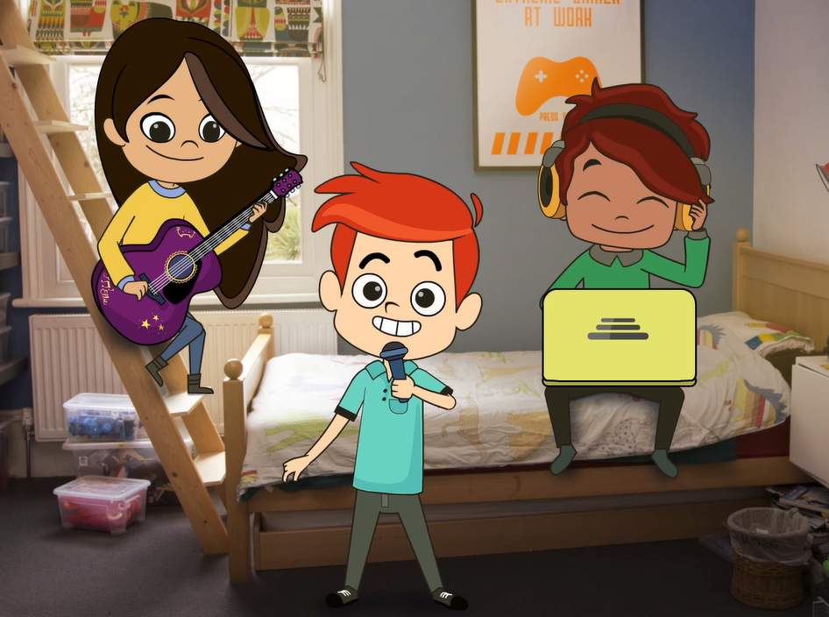
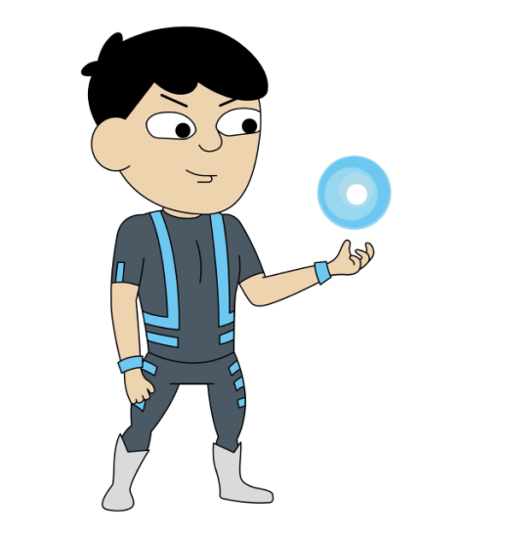
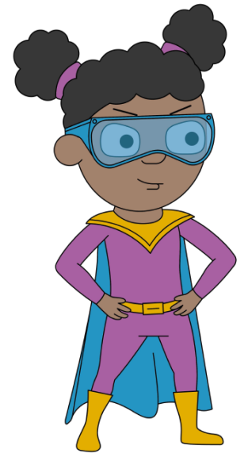
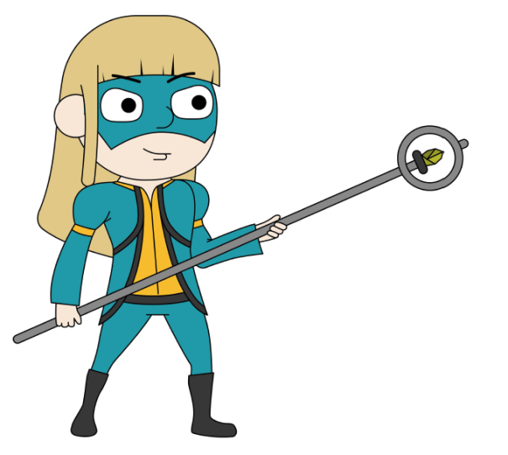
[Insert Jessie and Friends parents video]
Resources for primary aged children
4-7s: Jessie & Friends
8-11s: Play Like Share
& Band Runner Game
[Insert Play Like Share parents trailer]
Notes:
Insert YouTube video to slide – Jessie and Friends Parents video [Accessible from March 2019]
Non-subtitled version - https://youtu.be/Z8i7vnXQdvw
Subtitled version -
Insert video file to slide – Play Like Share Parents and Carers Trailer
Jessie & Friends – due for release March 2019
Jessie & Friends is a Thinkuknow education package for children aged 4-7 years. Jessie & Friends aims to give children the knowledge, skills and confidence they need to help them stay safe from sexual abuse, exploitation and other risks they may encounter online.
The animations and activities provide children with the opportunity to explore ideas like trust, false identity online, consent, and develop their confidence to ask an adult they trust for help if something online makes them feel uncomfortable.
Jessie & Friends does not depict any scenario involving an adult sexual offender and instead encourages children to focus on behaviours, not motivations which helps them identify and respond safely to strategies that sexual offenders typically use to groom children. It does so without raising confusing, frightening or age-inappropriate questions about why an adult might behave in this way towards a child.
Each animation has been specifically created for different age groups:
Episode 1 - Watching videos (4-5 years)
Episode 2 – Sharing pictures ( 5-6 years)
Episode 3 – Playing games (6-7 years)
Each episode ends in a catchy song, aimed to reinforce the films safety messages. More information for parents and carers can be found at www.thinkuknow.co.uk/parents/jessie-and-friends
Play Like Share
Play Like Share is one of the Thinkuknow resources for 8-10 year olds. It is a three episode animated series that follow the adventures of Alfie, Ellie and Sam as they form a band and enter their school’s Battle of the Bands contest, taking on the mean but ‘cool’ Popcorn Wizards as they go. The three friends learn that while the internet can help, they need to use it wisely and safely. The films teach children how to spot the early signs of manipulative, pressurising and threatening behaviour by people they might meet online, and develops their confidence to respond safely and get help.
You can watch Play Like Share with your child and use this to start a conversation about the internet and staying safe. All three episodes can be found on the Thinkuknow website for 8-10 year olds. You can download the Play Like Share Parents and Carers Factsheet for ideas and support on how to watch and discuss Play Like Share with your child, at Thinkuknow.co.uk/parents [If appropriate, offer Factsheet as a take-home handout].
Band Runner
Also on the Thinkuknow website for 8-10 year olds is a fun interactive game called Band Runner that helps 8-10 year olds learn how to stay safe from risks they might encounter online. Children can chose to play the game as the Play Like Share characters Ellie or Sam, and the game tasks them with helping Alfie to make safe choices online. Players run through school and collect stars for points, whilst using their guitars to eliminate all obstacles in their path as they try and make it to their next gig. If players miss a jump or take a tumble they then need to help Alfie solve an online safety dilemma to be able to continue play.

Slide 12
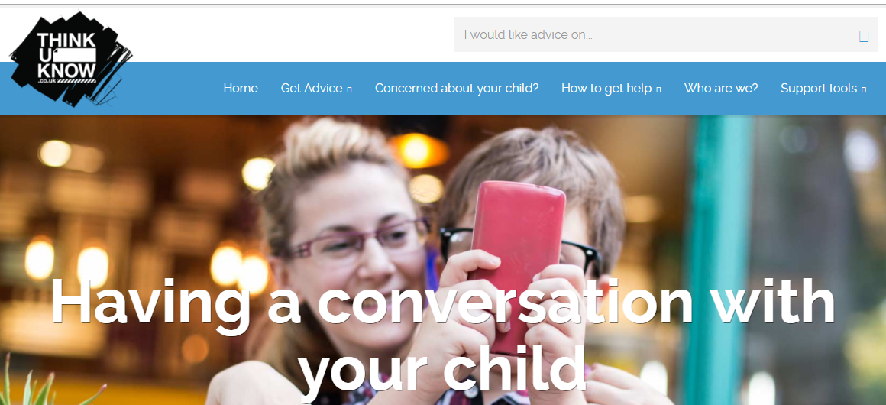
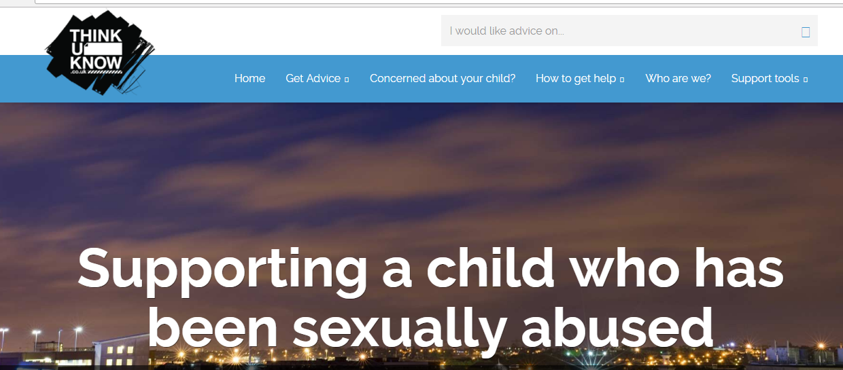
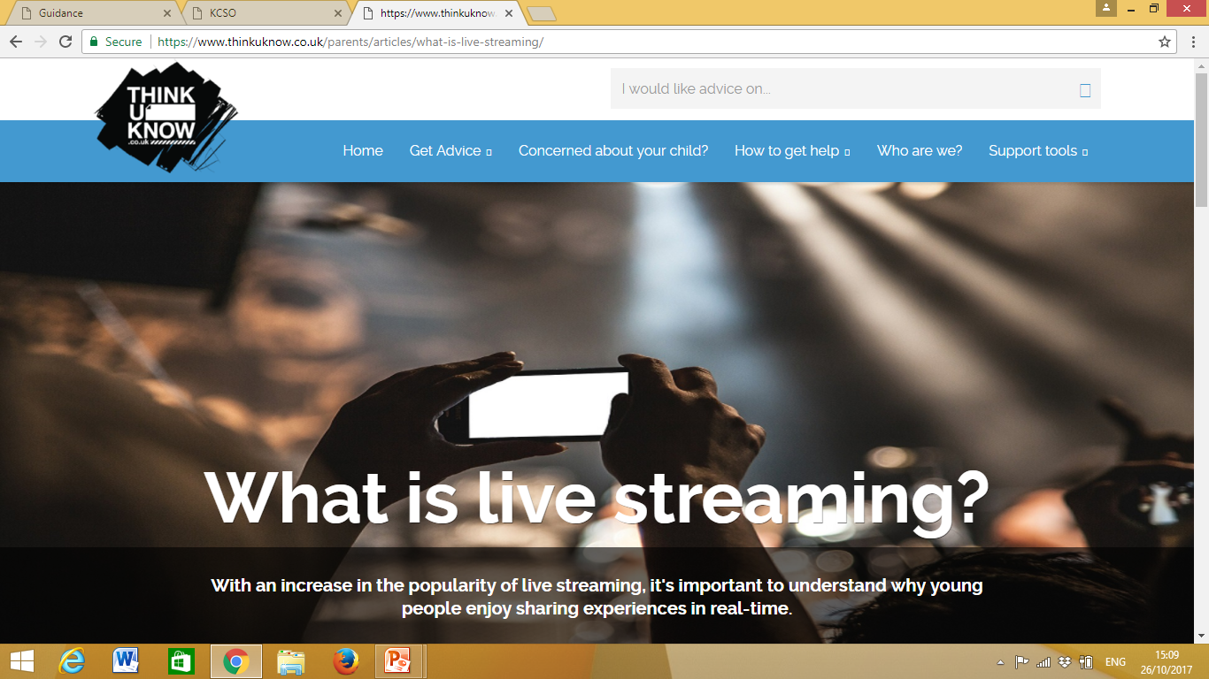
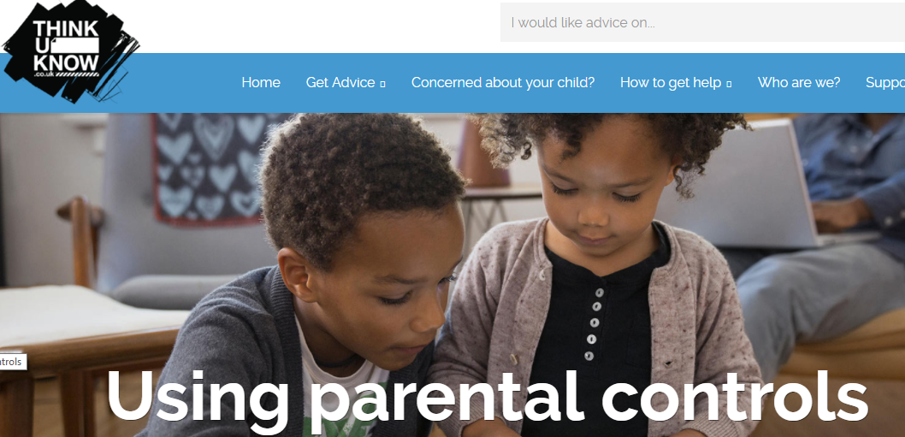
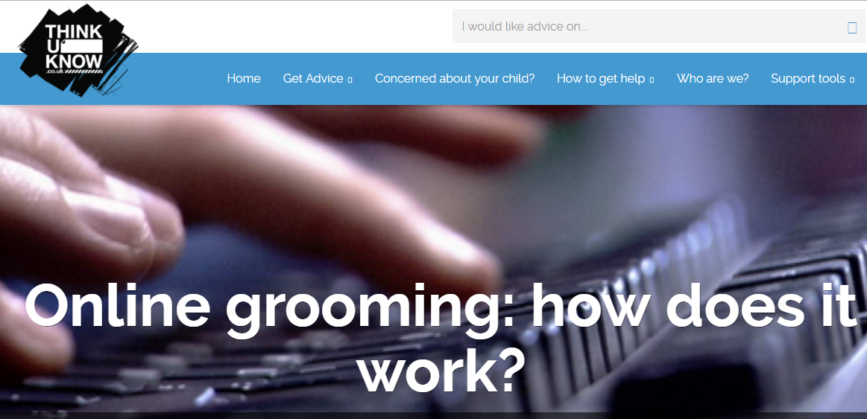
Resources for Parents and Carers
Notes:
Thinkuknow Parents and Carers website - The Thinkuknow Parents and Carers website contains a wealth of information and advice for parents and carers on keeping their children safe online. Parents and carers can visit www.thinkuknow.co.uk/parents for advice on topics such as: having a conversation with your child, using parental controls, understanding live streaming and supporting children who have been sexually abused.
The website is divided into three sections:
I need to report an incident – for information and support when something has already happened to a child or young person
I’m concerned about my child – for information and support when there are concerns about a child or young person
I’d like to understand more about keeping my child safe – for preventative information and advice on keeping children safe online

Slide 13
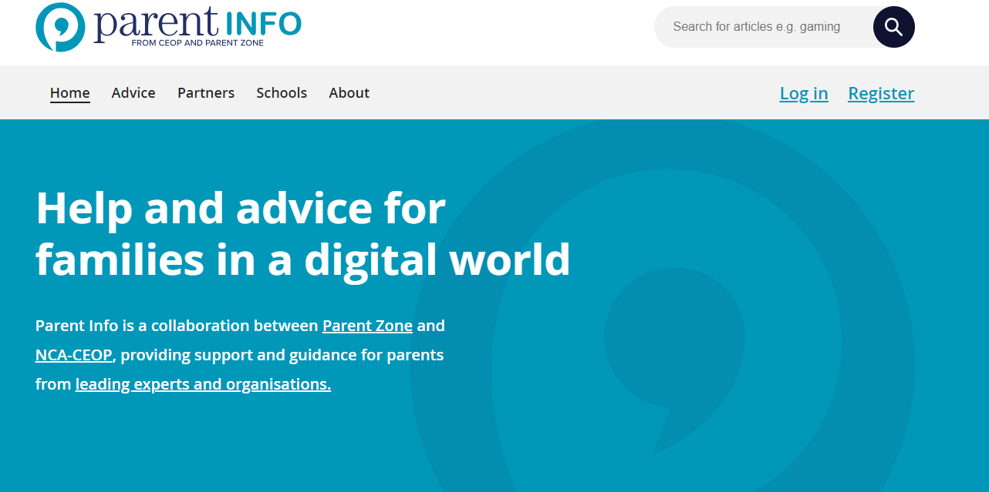
www.parentinfo.org
Notes:
Parent Info (www.parentinfo.org) is a partnership project between NCA-CEOP and the parent organisation Parent Zone. It’s a website and advice service for parents and carers, which aims to build the resilience of their children through articles, tips and advice. Articles are written by expert organisations on a range of different topics, covering all issues amplified by the internet. The website is divided into the following categories:
Games, apps and tech
Parenting
Safety and settings
Relationships and sex
Education and the future
Health and wellbeing

Slide 14

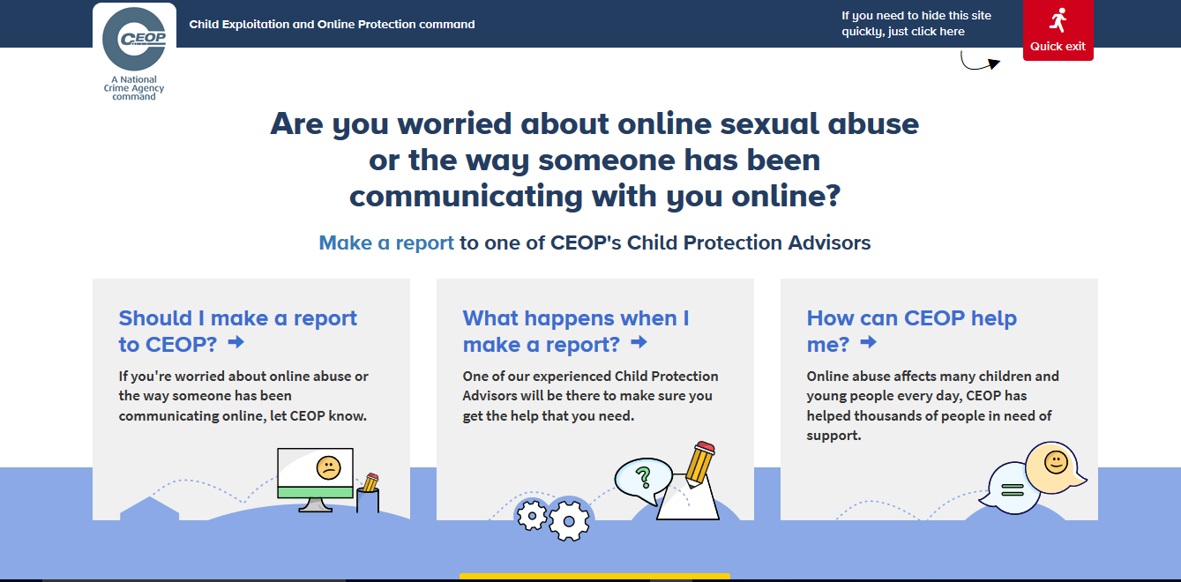

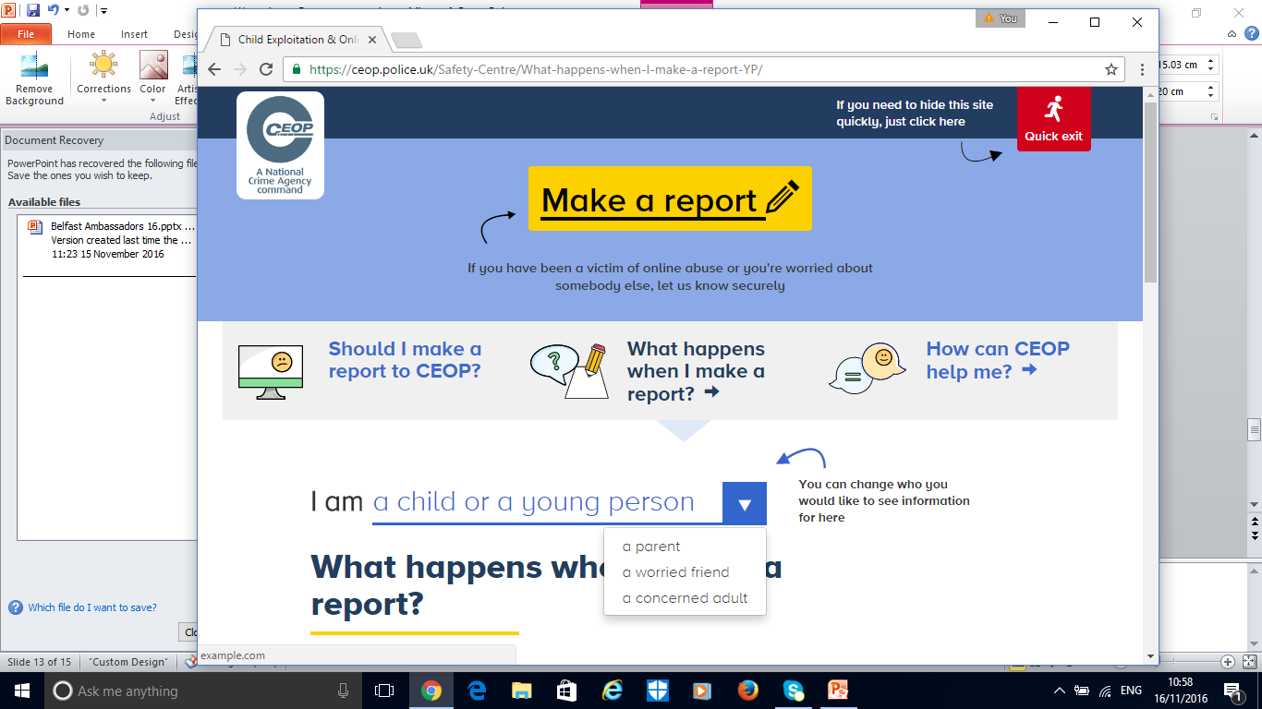
Reporting to NCA-CEOP – www.ceop.police.uk
Notes:
Note to presenter: Before delivering this section, familiarise yourself with NCA-CEOP’s website and advice pages by visiting www.ceop.police.uk.The website has information on:
When to report to NCA-CEOP
What happens when a report is made to NCA-CEOP
How NCA-CEOP can help
The NCA-CEOP website is known as the ‘safety centre’ as it hosts an online reporting tool, made specifically for children and young people in order for them to report concerns relating to online sexual abuse and exploitation directly to NCA-CEOP. Parents and carers can also report to NCA-CEOP if they are worried about a child or young person in their care. The buttons on the right hand side of the screen link to the safety centre. The Click CEOP button can be embedded on external websites, such as a school’s website (if you have the button on your organisations website tell audience where this can be found) and the ‘worried about something’ button is hosted on the Thinkuknow 8-10 year old website.
NCA-CEOP takes all reports seriously. The reporting form is designed to be as accessible as possible by children, but it is highly recommend that young children of primary school age seek the support of an adult they trust to help them make a report.
It is not possible to report to NCA-CEOP anonymously. NCA-CEOP advise any urgent reports where a child is in immediate danger should be reported to the local police force where the child is located.
Cyberbullying should not be reported to NCA-CEOP as it falls outside their remit of CSAE. Children and young people should be directed to speak to an adult they trust, and/or referred to Childline, if they would like to speak to someone about how they are feeling.

Slide 15




Staying up to date:
@CEOPUK
ClickCEOP
www.thinkuknow.co.uk
www.thinkuknow.co.uk/parents
www.ceop.police.uk/safety-centre
Notes:
For more information on Thinkuknow please visit – www.thinkuknow.co.uk
The NCA-CEOP ‘safety centre’ and reporting tool can be found at www.ceop.police.uk
You can also keep up to date by following NCA-CEOP on Twitter or Facebook.

